Slide 1
Key Finding:
The provided data suggests a ranking of countries based on success in attacks, with Iraq leading at 21,861, followed by Pakistan and Afghanistan. The presence of diverse nations like India, Colombia, and the United Kingdom in the top ten highlights global security challenges. These statistics underscore the importance of international efforts to address and prevent acts of aggression..
Key Finding:
The success rates of various attack types reveal that Bombing/Explosion is the most successful method at 48.57%, followed by Armed Assault and Assassination. Kidnappings and attacks on facilities show lower success rates. The presence of unknown methods underscores the complexity of addressing and preventing diverse forms of violence in security considerations.

Slide 2
Key Finding:
Examining success rates by weapon type reveals that Firearms and Explosives are the most successful, with 54,090 and 79,746 instances, respectively. Incendiary weapons also show high success. Unknown methods, Melee, and Chemical weapons exhibit varying success rates. Understanding these patterns is crucial for developing effective strategies to combat and prevent diverse forms of violence.
Key Finding:
The success rates of various target types indicate a range of vulnerabilities. Private citizens and property, military, and police targets have the highest success rates, emphasizing the challenges in safeguarding civilian and security personnel. Government, business, and educational institutions also face significant threats, highlighting the need for comprehensive security measures across sectors.

Slide 3
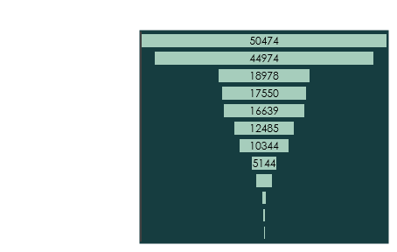
Key Finding:
The data on the number of attacks across regions indicates that the Middle East & North Africa and South Asia experience the highest frequency of incidents, with 50,474 and 44,974 attacks respectively. South America and Sub-Saharan Africa also face significant challenges, emphasizing the global distribution of terrorism and the importance of region-specific security measures.
Key Finding:
The data on the number of attacks across regions indicates that the Middle East & North Africa and South Asia experience the highest frequency of incidents, with 50,474 and 44,974 attacks respectively. South America and Sub-Saharan Africa also face significant challenges, emphasizing the global distribution of terrorism and the importance of region-specific security measures.

